Slide 1

Cows, Lakes, and a JuMP extension for multi-stage stochastic programming
Oscar Dowson
The University of Auckland
odow003@aucklanduni.ac.nz

Slide 2
Julia meats Daisy in the field of multi-stage stochastic optimisation
Oscar Dowson
The University of Auckland
odow003@aucklanduni.ac.nz

Slide 3
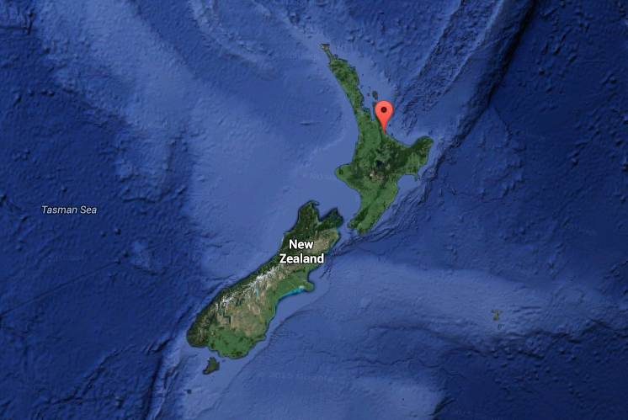

Slide 4
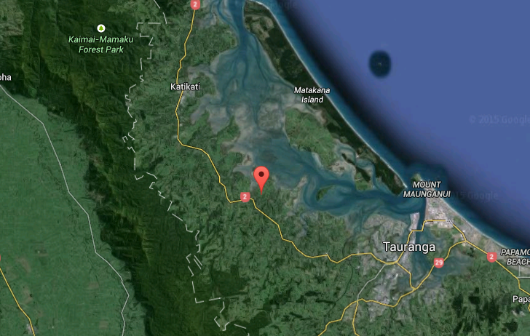

Slide 5
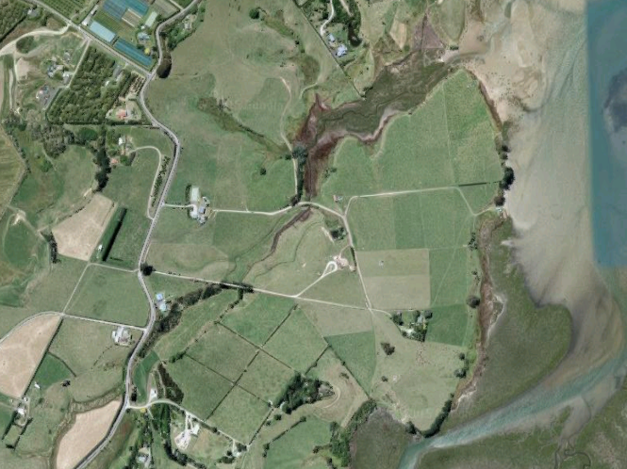

Slide 7
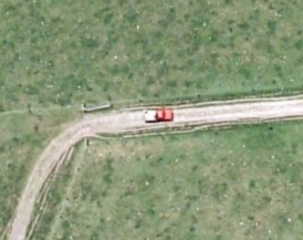

Slide 10
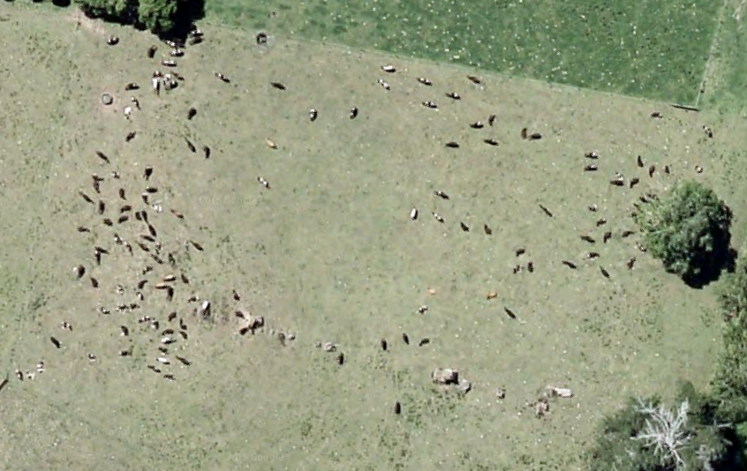

Slide 11
Help!
I don’t know what multi-stage stochastic optimisation is!

Slide 12
Hydro-Thermal Scheduling
The “lake” part of the talk

Slide 13
Reservoir
Hydro-turbine

Slide 14
Reservoir
Hydro-turbine

Slide 15
Rainfall
Reservoir
Hydro-turbine

Slide 16
Rainfall
Reservoir
Hydro-turbine
Demand

Slide 17
Rainfall
Coal
Reservoir
Hydro-turbine
Steam-turbine
Demand

Slide 18
The Milk Output Optimiser
The “cow” part of the talk

Slide 19
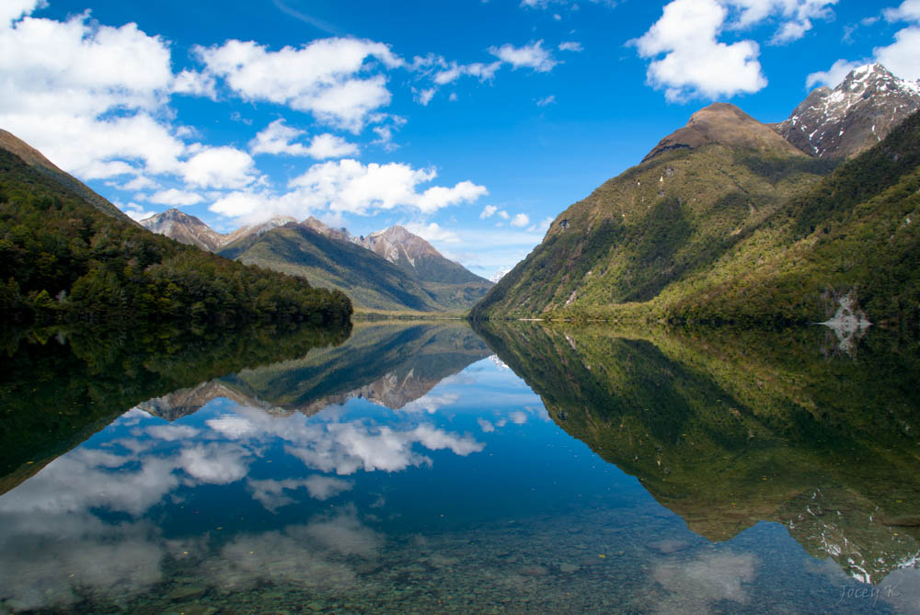
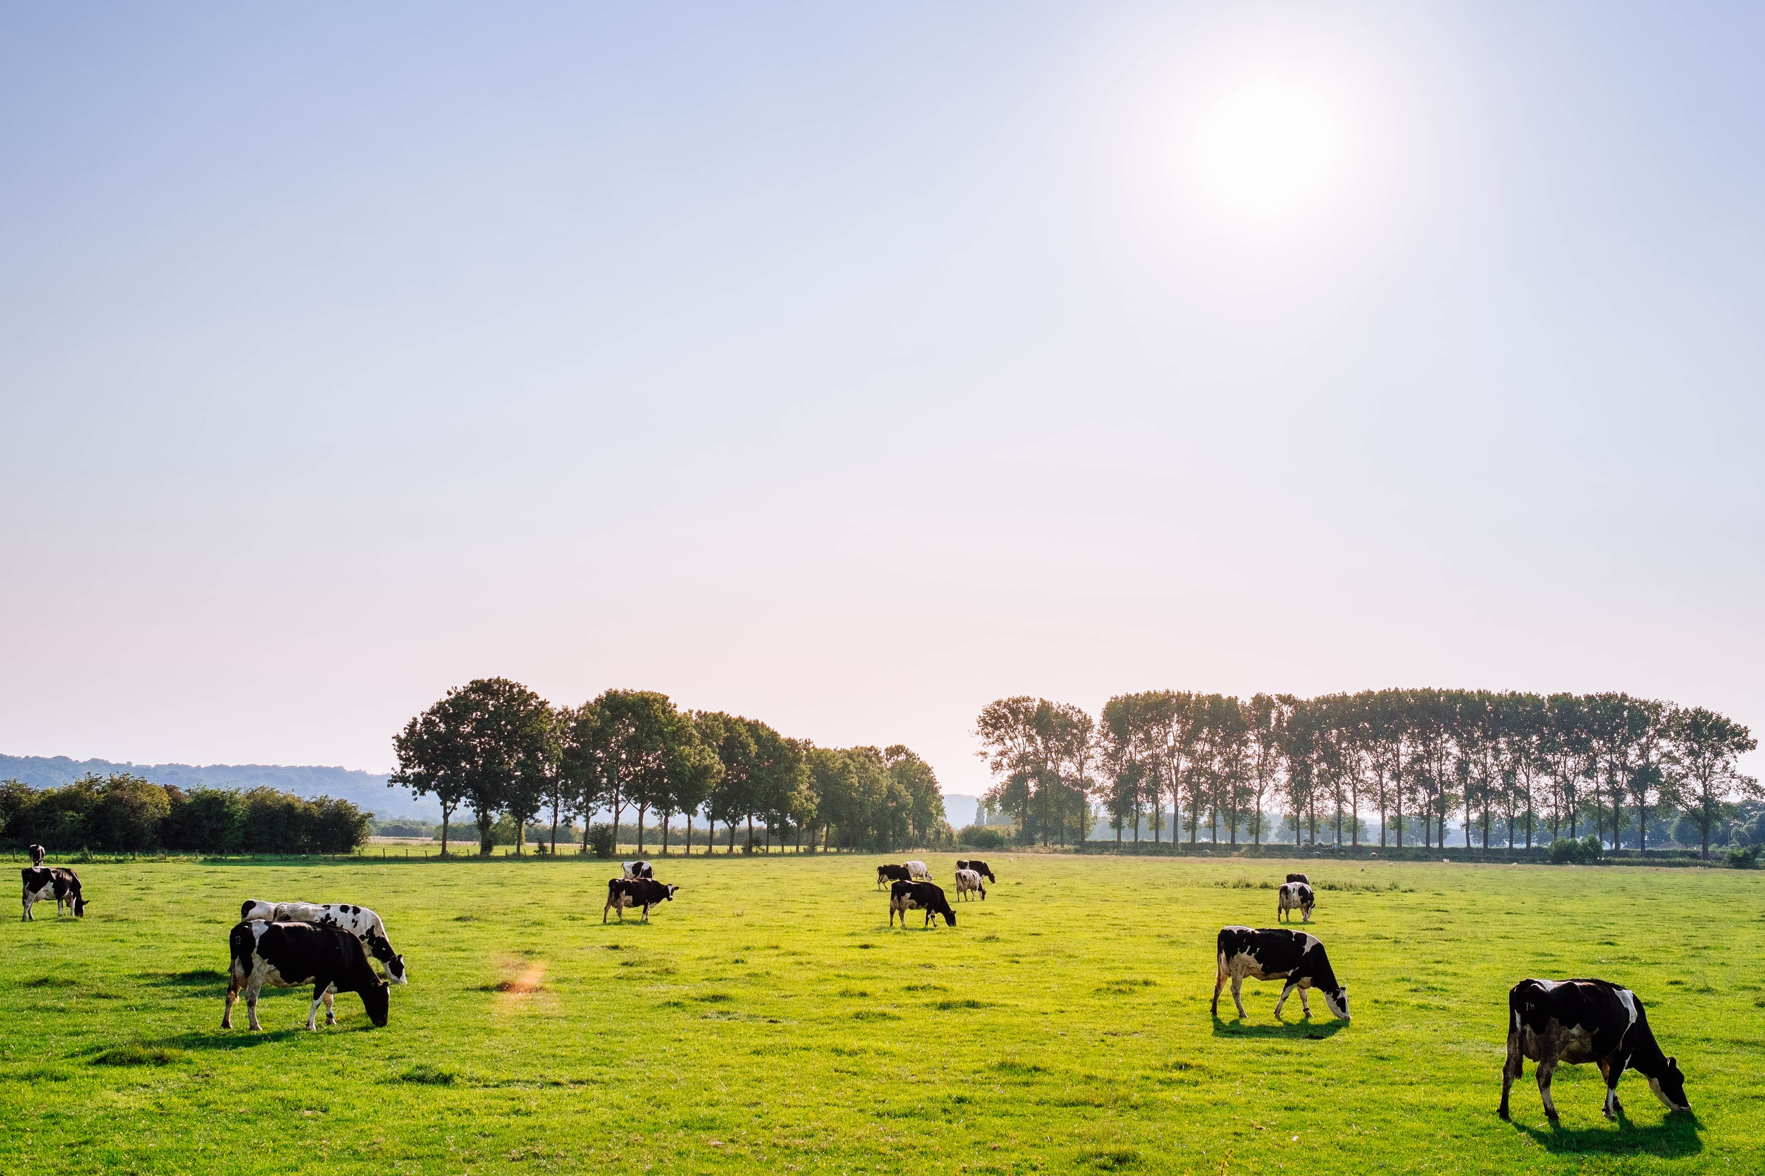
Paddocks are Lakes of grass and Cows are Lakes of energy

Slide 20
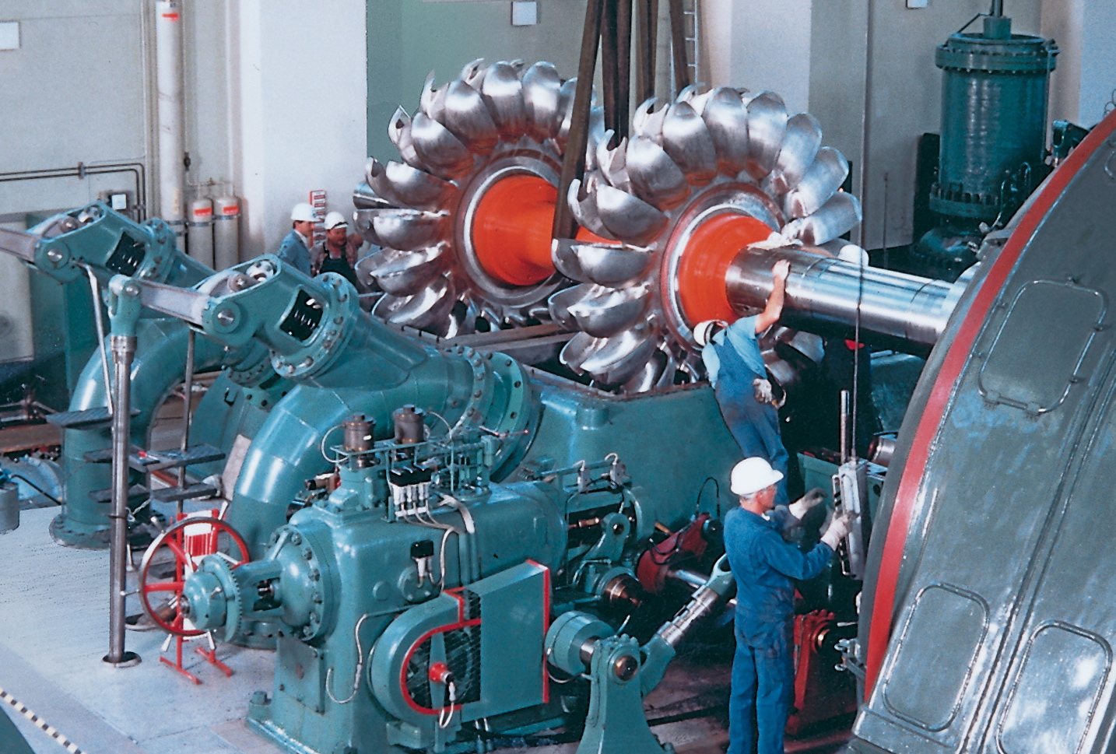
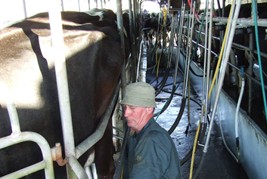
Paddocks are Lakes of grass and Cows are Lakes of energy
Turbine grass into the cow and Turbine the cow to produce milk

Slide 21

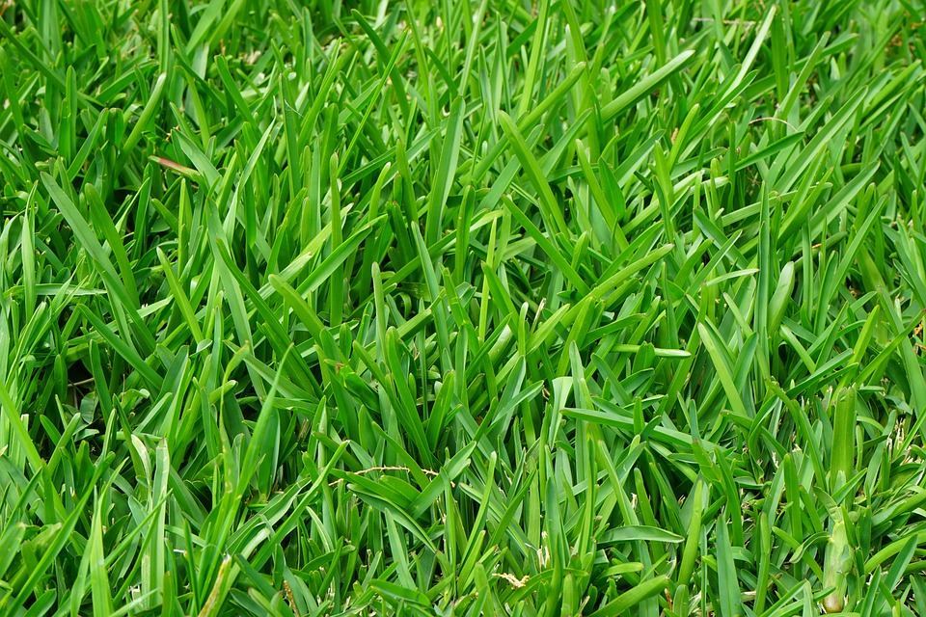
Random grass growth instead of rainfall

Slide 22
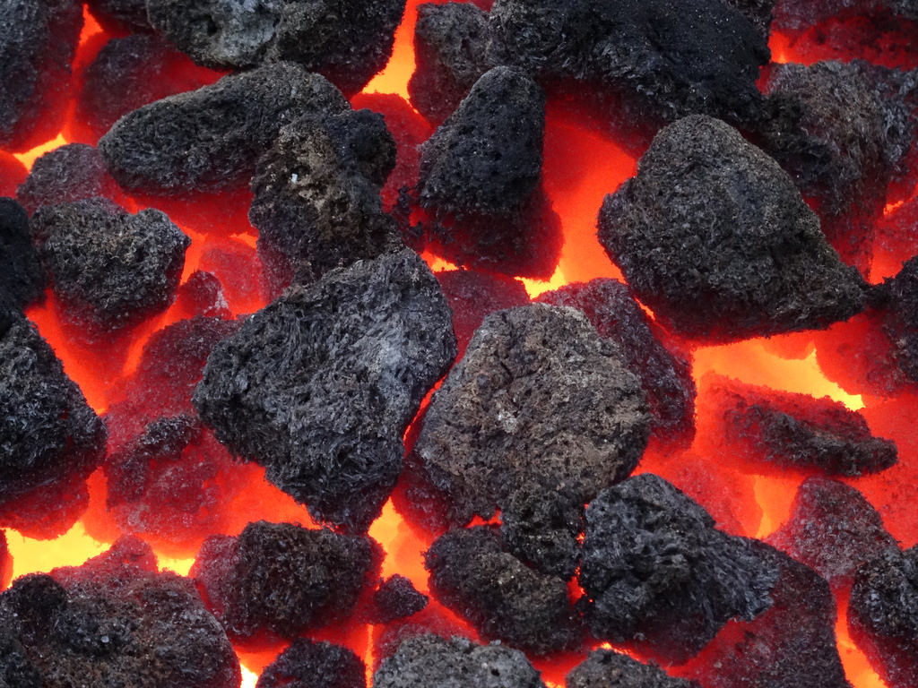
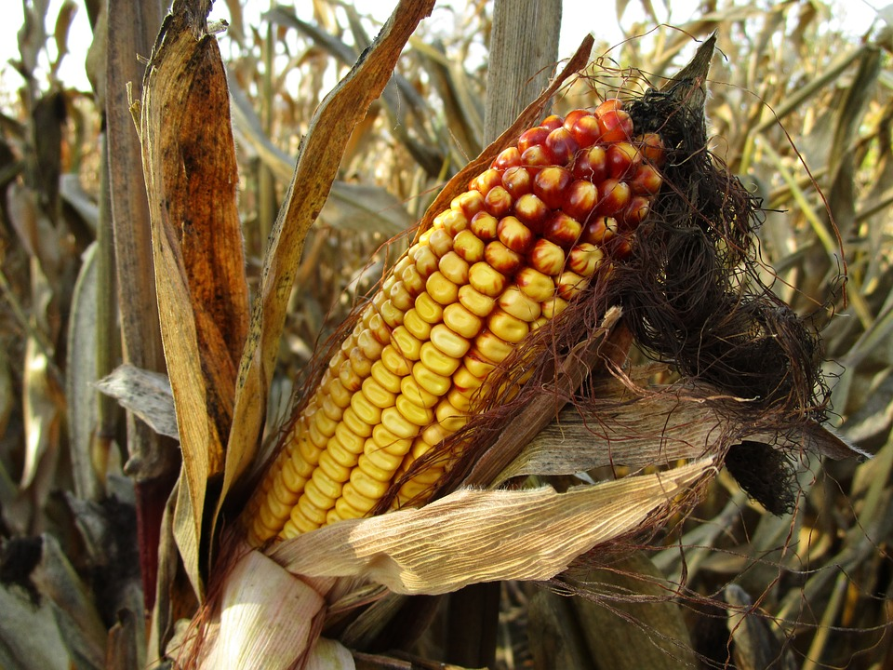
Random grass growth instead of rainfall
Make up the difference with maize instead of coal

Slide 23
Solution Technique
Stochastic Dual Dynamic Programming

Slide 24
SDDP
Discrete time
Discrete noise
Continuous state, action
Convex Bellman function

Slide 25
AMPL
Hydro-thermal
Scheduling
C++
MOO
Python

Slide 26
This seems inefficient
Why not do it in Julia?

Slide 27
That’s exactly what people have done over the last year or so…
SDDP.jl https://github.com/odow/SDDP.jl
StochDynamicProgram.jl https://github.com/JuliaOpt/StochDynamicProgram.jl
StructDualDynProg.jl https://github.com/blegat/StructDualDynProg.jl
PSR (Commercial)
A few other private research codes

Slide 28
That’s exactly what people have done…
SDDP.jl https://github.com/odow/SDDP.jl
StochDynamicProgram.jl https://github.com/JuliaOpt/StochDynamicProgram.jl
StructDualDynProg.jl https://github.com/blegat/StructDualDynProg.jl
PSR (Commercial)
A few other private research codes

Slide 29
Moa.jl
Multi-stage Optimisation Application

Slide 30
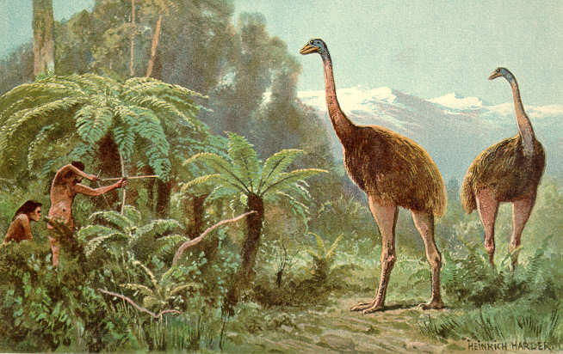

Slide 31
Hydro-scheduling
Moa.jl
MOO
JuMP.jl
…

Slide 32
But is it any good?

Slide 33
But is it any good?
Yes.

Slide 34
Is it any good?
Similar performance to problem-specific C++
Much easier to apply to new problems
Much easier to modify old problems
Easier to code (and test) new heuristics which significantly improve performance

Slide 35
Is it any good?
Similar performance to problem-specific C++
Much easier to apply to new problems
Much easier to modify old problems
Easier to code (and test) new heuristics which significantly improve performance

Slide 36
Is it any good?
Similar performance to problem-specific C++
Much easier to apply to new problems
Much easier to modify old problems
Easier to code (and test) new heuristics which significantly improve performance

Slide 37
Is it any good?
Similar performance to problem-specific C++
Much easier to apply to new problems
Much easier to modify old problems
Easier to code (and test) new heuristics which significantly improve performance

Slide 38
What should I take away from this talk?

Slide 39
What should I take away from this talk?
I know what SDDP is:
Let’s talk.
github.com/odow/SDDP.jl

Slide 40
What should I take away from this talk?
I know what SDDP is:
Let’s talk.
github.com/odow/SDDP.jl
I don’t know what SDDP is:
New Zealand dairy farmers may someday use Julia to help them make better decisions under uncertainty.

Slide 41
